Slide 1


ANP-C9180
PROJECT ON
ANALYTICS
CHIRAG SHARMA
AF0438100

Slide 2

PROBLEM STATEMENT
Nitin works as a Graphic Designer in a new company. He earns Rs 15,000/- per month. He is planning to buy a scooter for his daily commute to the office.
For the last couple of months, Nitin is not able to save at all for his scooter. His friend Ayush told him that he needed to figure out where most of the money goes and cut down that expense.
Help Nitin increase his savings by removing some unnecessary expenses.

Slide 3

CONTENT
01
PART - 01 EXPENSE DETAILS FOR JUNE
02
PART - 02 EXPENSE DETAILS FOR 6 MONTHS

Slide 4
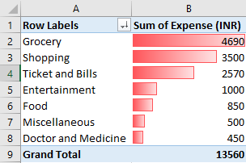
PART NO 1
EXPENSE DETAILS FOR JUNE
Task 1. The category with the highest expense amount
As per we can nitin earn around 15,000 and in June month he has spend 13,560 still he is saving 1,440 There.
As per analysis we can see that Nitin spending more money on grocery , shopping , ticket and bills .
which is total around 10,760 which is huge.

Slide 5

PART NO 1
EXPENSE DETAILS FOR JUNE
Task 2. Total expense amount against entertainment and shopping
As per this analysis we can see from the total 13,560 around 33% in the june month nitin is expense in shopping and entertainment
.

Slide 6
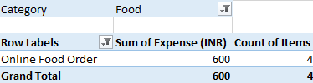
PART NO 1
EXPENSE DETAILS FOR JUNE
Task 3. Number of times Nitin has ordered food online and the amount spent for it
Nitin has orderd food online 4 times

Slide 7
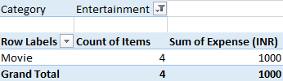
PART NO 1
EXPENSE DETAILS FOR JUNE
Task 4. Number of times Nitin has watched a movie.
Nitin has watched 4 times movie .

Slide 8
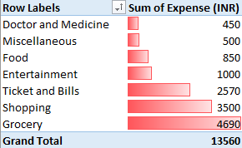
PART NO 1
EXPENSE DETAILS FOR JUNE
Task 5. The less essential category that Nitin may remove to increase his savings
Nitin can save huge amoun inside entertainment , shopping and grocery.
Nitin can Save upto 50% from total amount after spending less in entertainment , shopping and grocery.

Slide 9
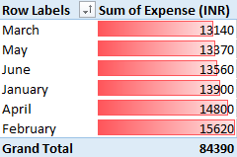
PART NO 2
EXPENSE DETAILS FOR 6 MONTHS
Task 1. The month-wise trend of expenses and find out the month Nitin spent the most
Nitin has expensed huge amount inside february, April and January.

Slide 10
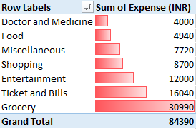
PART NO 2
EXPENSE DETAILS FOR 6 MONTHS
Task 2. Visual representation of expenses against different categories
Nitin has huge sume amount wasted in the shopping , entertainment.

Slide 11
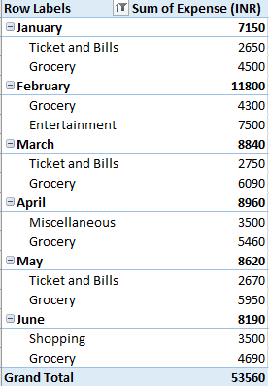
PART NO 2
EXPENSE DETAILS FOR 6 MONTHS
Task 3. Top 2 categories with higher expenses for each month
In every month most common is grocery, ticket and bills .
Where Nitin has higher expenses.

Slide 12

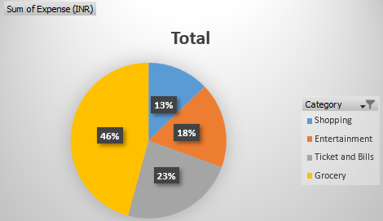
PART NO 2
EXPENSE DETAILS FOR 6 MONTHS

Slide 13
PART NO 2
EXPENSE DETAILS FOR 6 MONTHS
Task 4. Recommendations on how can Nitin increase his savings
Over all months expense of nitin we can see that 46 % grocery, 23 % ticket and bills, 13% shopping, 18 %entertainment are were nitin can increase the saveings.
By Reduce the huge amount inside Entertainment and Shopping.
Reduce the amount inside Grocery and ticket and bills buy using apps which give cash back and reward point that can be used for next time buying Grocerys And make the list grocerys which is common need evey month buy it large quality in less amount offers. So the next months grocerys amount will automatically get reduce and Nitin can save that amount for Buying Scooter.

Slide 14


THANK YOU

